Slide 1


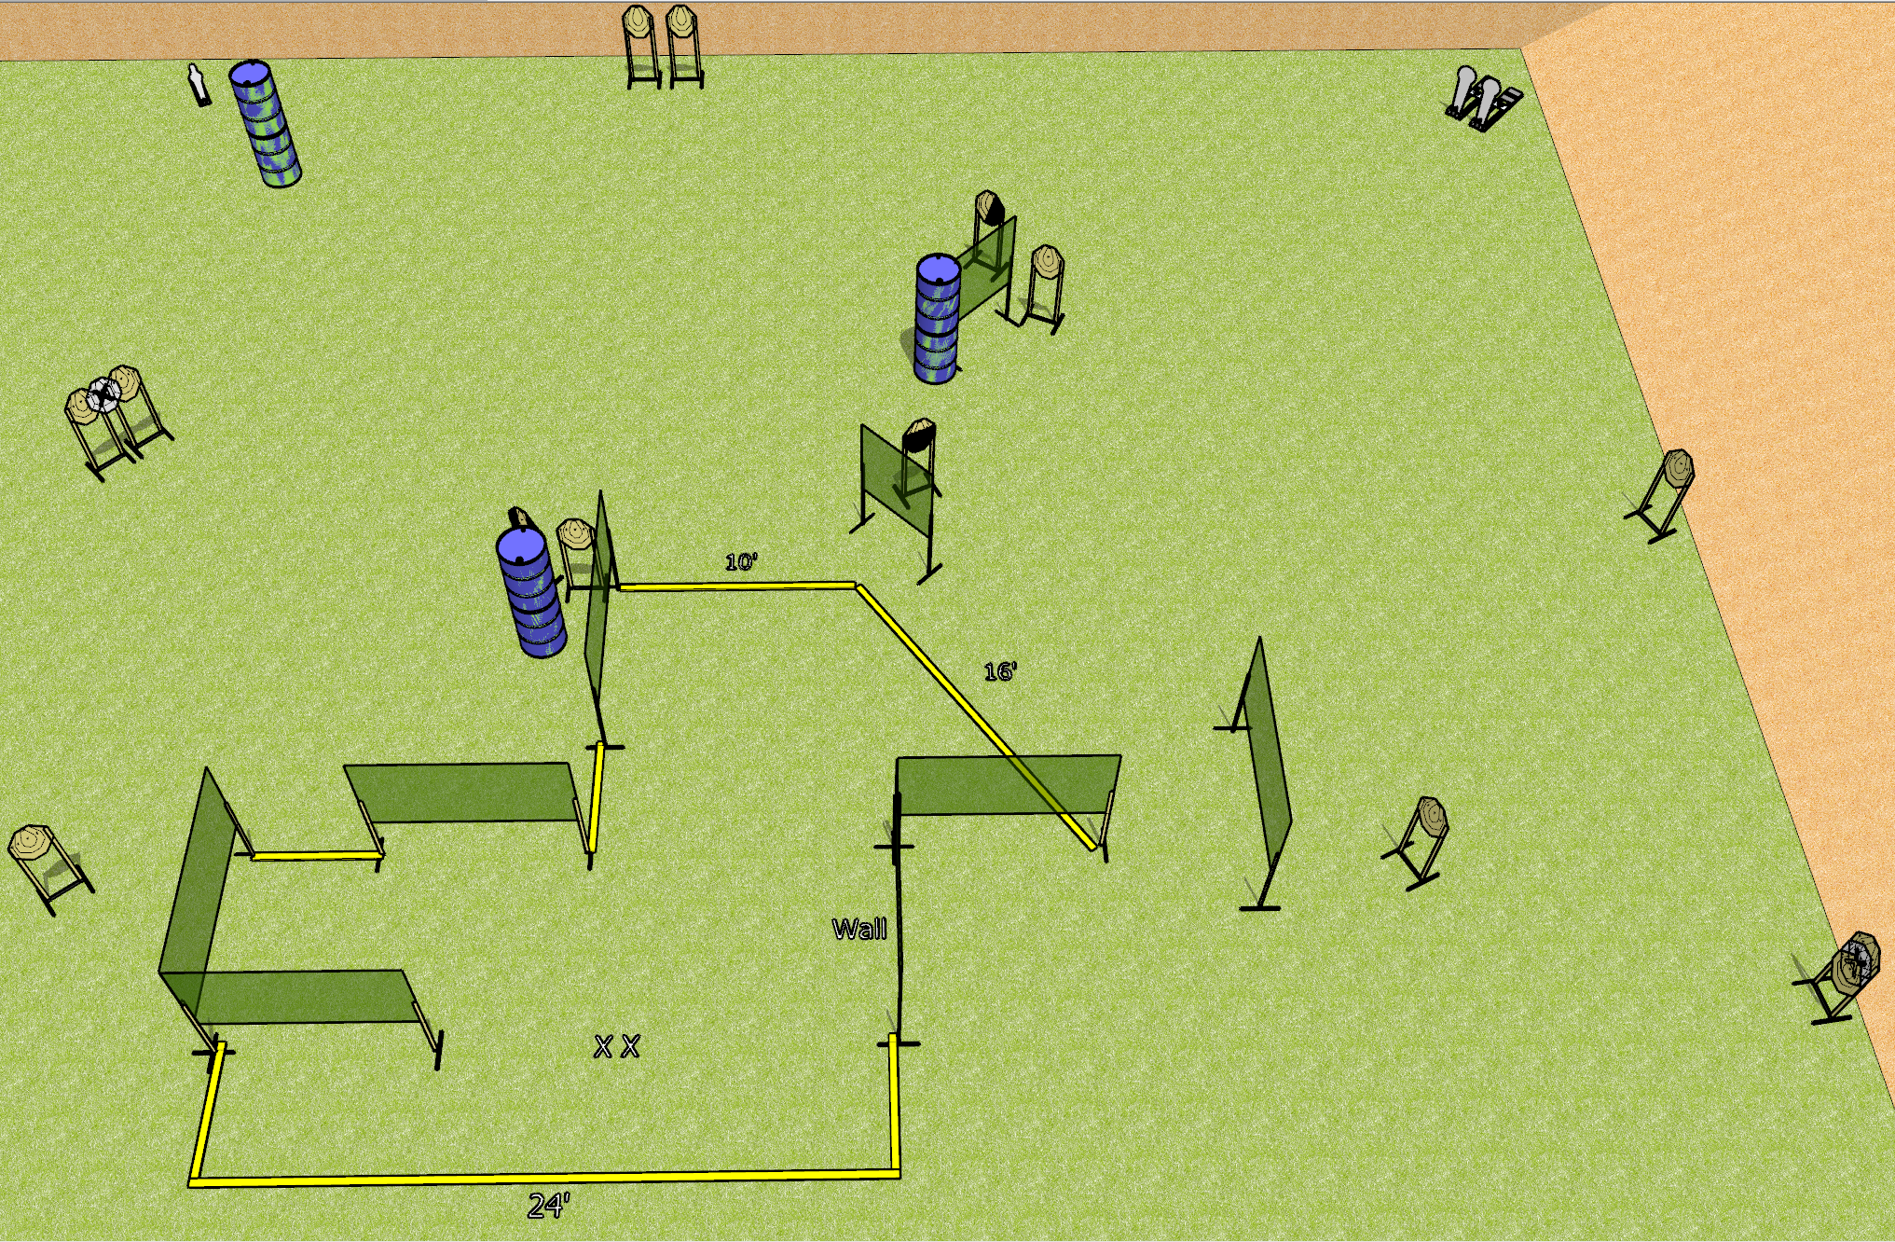
 | Dothan Gun Club – USPSA Match Crazy Face Course Designer : Drew Coleman
Round Count 31 rounds 14 IPSC 2 colt poppers, 1 mini popper
Equipment List 4 medium fault lines 16 wall feet 1 tux, 1 right diag, 1 50% 13 paper (11 + 2 NS)

Slide 2
Crazy Face
Written Stage Briefing
Crazy Face is a 31 round, 155 point, Comstock course of fire. There are 14 IPSC targets, 2 colt poppers, and 1 mini popper. The best 2 hits on paper will score, and steel must fall to score. The start signal is audible.
Handgun start position is feet on X’s, wrists below belt. Handgun is loaded and holstered.
PCC start position is feet on X’s, stock on belt. Loaded carbine is held with both hands, safety on.
On start signal, engage targets as they become available from within the shooting area.

